Slide 1

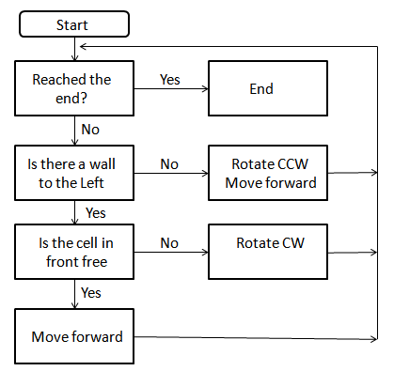



Left Hand Rule algorithm

Slide 2
Left Hand Rule algorithm

Slide 3
Left Hand Rule algorithm

Slide 4
Left Hand Rule algorithm

Slide 5
Left Hand Rule algorithm

Slide 6
Left Hand Rule algorithm

Slide 7
Left Hand Rule algorithm

Slide 8
Left Hand Rule algorithm

Slide 9
Left Hand Rule algorithm

Slide 10
Left Hand Rule algorithm

Slide 11
Left Hand Rule algorithm

Slide 12
Left Hand Rule algorithm

Slide 13
Left Hand Rule algorithm

Slide 14
Left Hand Rule algorithm

Slide 15
Left Hand Rule algorithm

Slide 16
Left Hand Rule algorithm

Slide 17
Left Hand Rule algorithm

Slide 18
Left Hand Rule algorithm

